Slide 1
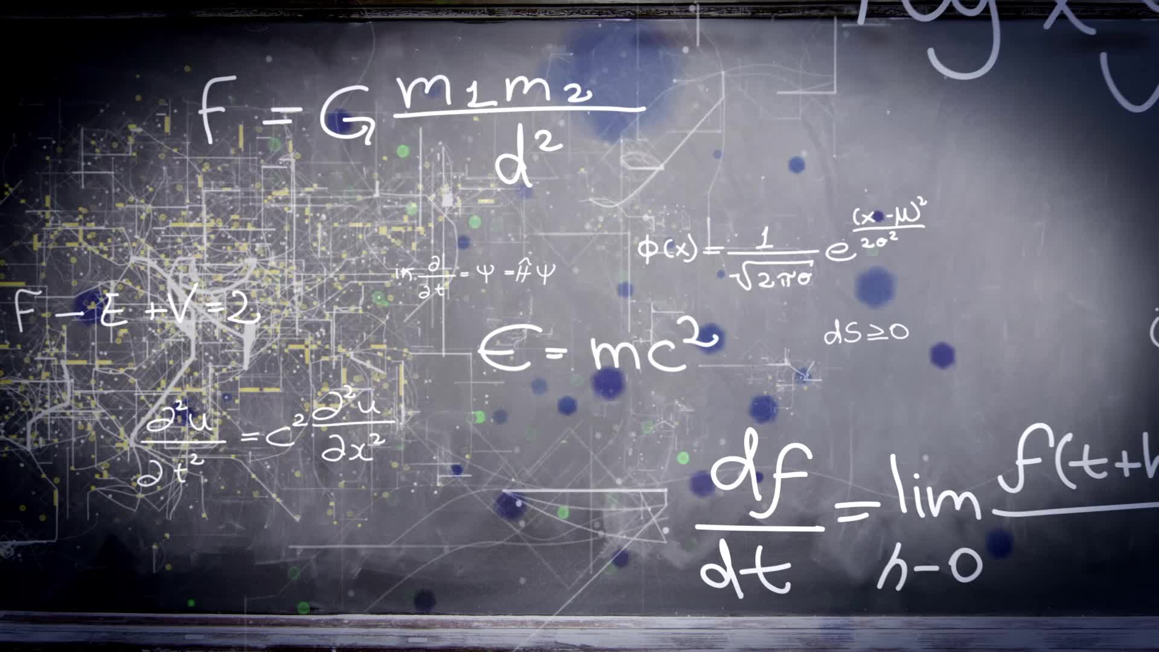
Chapter 3.6:
A Summary of Curve Sketching
HONORS CALCULUS/CALCULUS

Slide 2
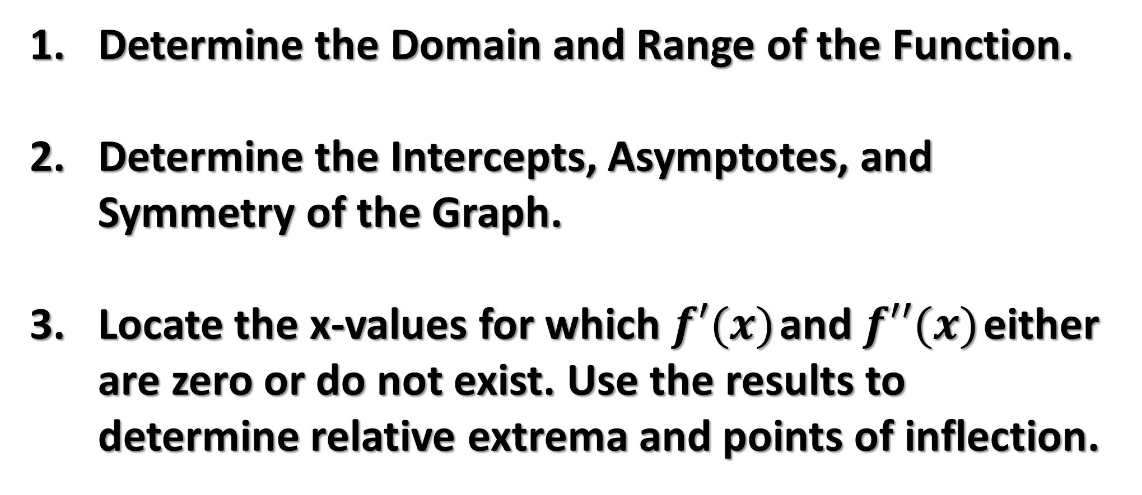
Guidelines for Analyzing the Graph of A Function
Determine the Domain and Range of the Function.
Determine the Intercepts, Asymptotes, and Symmetry of the Graph.
Locate the x-values for which $f′(x)$ and $f′′(x)$ either are zero or do not exist. Use the results to determine relative extrema and points of inflection.

Slide 3

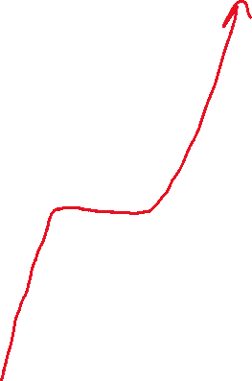

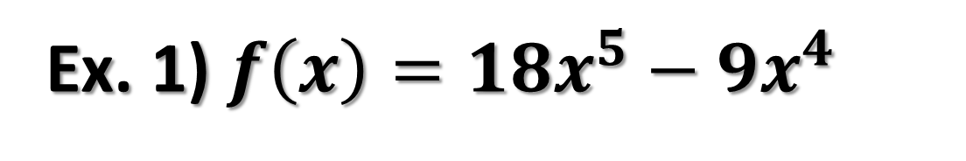


Ex. 1) $f\left(x\right)={18x}^{5}−9x^{4}$

Slide 4







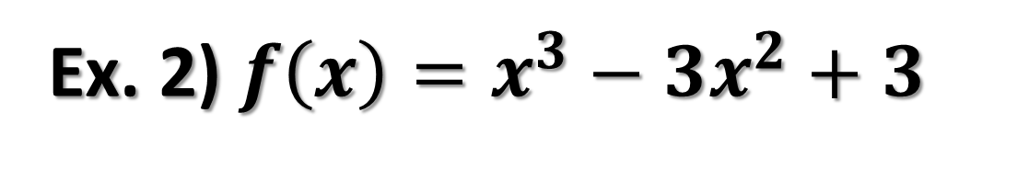







Ex. 2) $f\left(x\right)=x^{3}−3x^{2}+3$

Slide 5



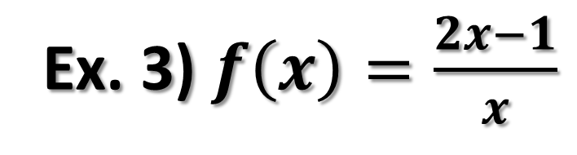
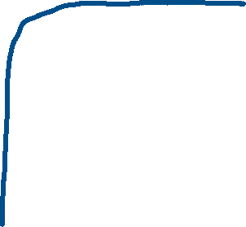


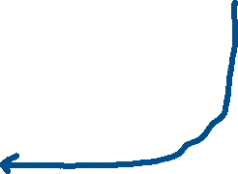

Ex. 3) $f\left(x\right)=\frac{2x−1}{x}$

Slide 6



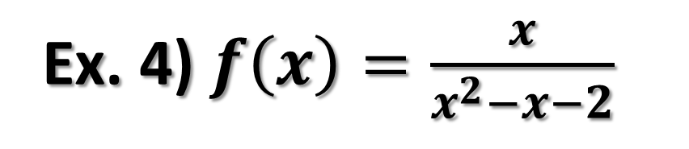





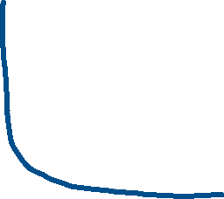
Ex. 4) $f\left(x\right)=\frac{x}{x^{2}−x−2}$

Slide 7

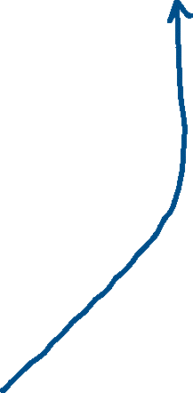

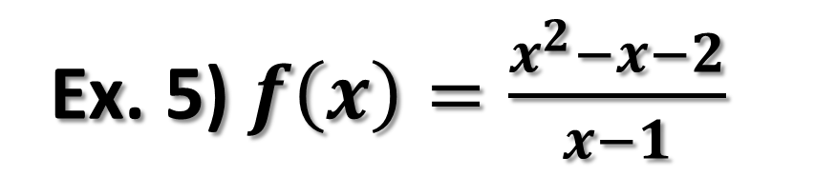





Ex. 5) $f\left(x\right)=\frac{x^{2}−x−2}{x−1}$

